Slide 1
SSW-555: Agile Methods for Software Development
Dynamic Systems Development Method (DSDM)
Instructor: Dr. Nafiseh Ghorbani
Department of Systems and Enterprises
Stevens Institute of Technology

Slide 2

Today's topic
Rapid Application Development (RAD)
Dynamic Systems Development Method (DSDM)
Core techniques of RAD and DSDM

Slide 3
Rapid: the precursor to Agile (1970s)
The traditional software development model was based on a Customer-Supplier relationship
Where the roles of the customer (client) and the supplier (developer) are clearly defined and separate.
The Customer (often a business or organization) defines the requirements and provides the specifications for the software.
The Supplier (software development team or company) is responsible for designing, developing, and delivering the software based on the provided specifications.
This relationship is often more transactional and one-directional, where the customer specifies what they want, and the supplier develops it.

Slide 4
Rapid: the precursor to Agile (1970s)
The traditional software development model was based on a Customer-Supplier relationship
Communication between the two is typically more formal, with fewer iterations or opportunities for feedback once the project is underway.
The focus is on delivering a finished product according to the agreed-upon requirements.
In contrast, more modern methods like Agile emphasize collaboration between the customer and supplier throughout the development process, allowing for flexibility, feedback, and continuous improvement as the project evolves.

Slide 5
Rapid: the precursor to Agile (1970s)
Used a traditional engineering model
Create design, construct solution, and deliver to customer
Fixed contract between customer and supplier
E.g., big government agency and software supplier
Fixed schedule, e.g., 1-2 years
Requirements negotiated up front
Customers and developers were independent and frequently didn’t trust each other

Slide 6
Rapid: the precursor to Agile (1980s)
Companies created in-house IT departments
e.g., create new reports from an existing database or automate manual processes
Customers and suppliers work for the same company In-house development could use a different model
The people building the system (developers) and the people using or requesting it (customers/business team) are part of the same organization
They are not external vendors or clients
Why this matters
Communication is faster and easier
Feedback happens quickly
Less need for formal contracts or strict documentation

Slide 7
Rapid: the precursor to Agile (1980s)
Customers and suppliers work for the same company In-house development could use a different model
Schedule could trade features for speed
When teams work internally, they can be flexible and if needed, they can deliver fewer features to finish faster and on schedule.
Requirements could be changed during development
No need to renegotiate contract terms and conditions
Customers and developers could work together

Slide 8
Rapid Application Development (RAD)
Originally developed in the 1970s by Dan Gielan at New York Telephone Co's Systems Development Center
Later codified by James Martin at IBM in his book Rapid Application Development, 1991
Reduces development time by:
Substituting prototypes for requirements specifications
Using existing databases, data models, and tools
Trading features for speed
Implementing most important features first
Adding more features incrementally

Slide 9
RAD Process
Requirements Planning phase – Users, managers, and IT staff members discuss requirements
User design phase – Users interact with systems analysts and develop reusable (evolutionary) prototypes
Construction phase – Users continue to participate and can still suggest changes or improvements as actual screens, or reports are developed
Cutover phase – Data conversion, full-scale testing, system changeover, user training, The Cutover phase is when the new system:
Goes live
Replaces the old system (if there is one)
Starts being used by real users
Think of it as the “launch” or “go-live” moment.
Repeat until done

Slide 10
RAD Techniques
Facilitated joint workshops (JAD)
Customers and developers
Evolutionary prototyping evolving into finished products
Time boxed incremental delivery
Strict schedules that can’t be changed
Drop features rather than miss the deadline
Small teams including users (6- 12)

Slide 11
RAD Techniques
CASE (Computer-Aided Software Engineering) tools:
In RAD (Rapid Application Development), CASE tools are software tools that help developers design, build, and maintain systems faster and more efficiently.
Rapid GUI (Graphical User Interface) development, e.g., Visual Basic
GUI development means creating the visual interface that users interact with in a software application
Assumes simple data models
Some commonly known tools include:
Visual Paradigm
Microsoft Visio
Think of CASE tool like Microsoft PowerPoint:
You (the developer) use its GUI to create slides (software design)
The slides themselves are not the GUI of your app; they’re just a tool to build it.

Slide 12
Dynamic Systems Development Method (DSDM)
Developed in England in the 1990s
Formalization of Rapid Application Development (RAD)
DSDM Consortium:
Created in 1994 by 16 European companies
Purpose: "jointly developing and promoting an independent RAD framework" by combining their best practice experiences
Publishes standards and supporting material

Slide 13
DSDM Principles
Active user involvement is imperative
DSDM teams must be empowered to make decisions
The focus is on frequent, incremental delivery of products
Fitness for business purpose is the essential criterion for acceptance of deliverables, i.e. meet the business need
Iterative and incremental development is necessary to converge on an accurate business solution

Slide 14
DSDM Principles
All changes during development are reversible
Requirements are base lined only at a high level
Use prototypes to define the details
Testing is integrated throughout the lifecycle
A collaborative and co-operative approach between all stakeholders is essential, i.e. customer and supplier are on the same team

Slide 15
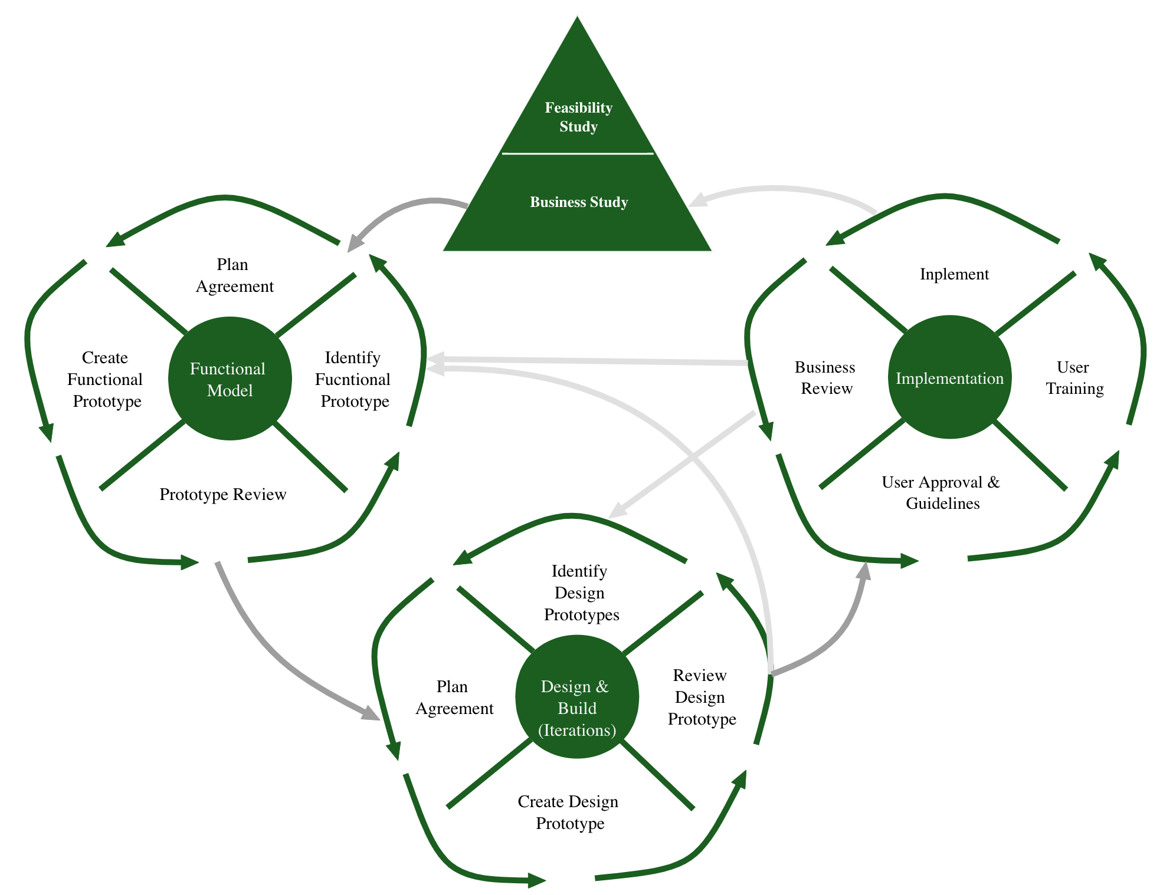
DSDM Process
Modified version based on Agile Software Development Ecosystems By Jim Highsmith, Figure 18.1. The DSDM Development Process

Slide 16
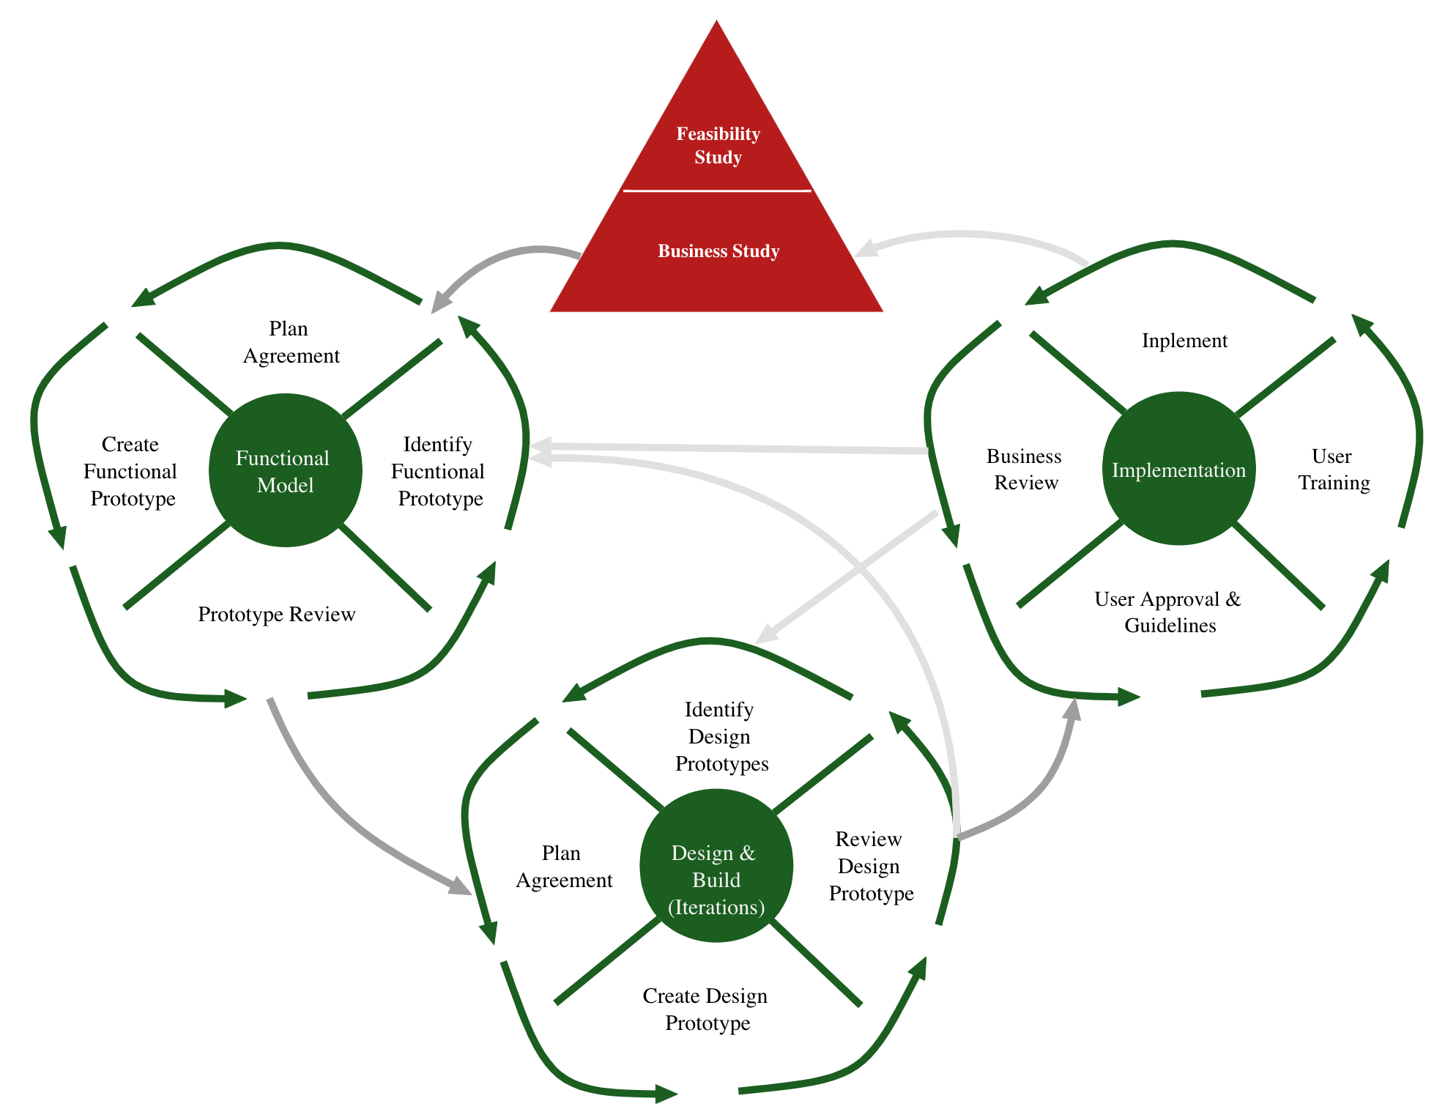
Pre-project phase
Decide whether to start project
Identify stakeholders, especially:
Visionary
Project Manager
Plan feasibility study

Slide 17
Pre-project phase
Initial phase that occurs before the actual development work begins.
The purpose of this phase is to set the stage for the project by aligning key stakeholders, establishing project goals, and preparing the project for a successful launch.
It’s a critical phase that helps ensure that the project is well-defined, properly scoped, and ready for the next steps in the development process.

Slide 18
Pre-project phase
In essence, the Pre-project Phase ensures that the project is worth undertaking and is well-prepared before diving into more detailed planning and development.
It’s about setting a strong foundation for the success of the project.

Slide 19
Feasibility Study
Starts with a Facilitated Joint Workshop
Includes users and developers
Produces a Feasibility Report:
Short business case
Suitability of DSDM
Early investigation of requirements
Also produces:
Outline plan with schedules and budget
Risk log
May produce a first prototype

Slide 20
Feasibility Study
The main goal of this phase is to assess whether the proposed project is feasible and viable from a technical, financial, and operational perspective before fully committing to the development process.
In the Feasibility Phase, the focus is on determining whether the project can be realistically delivered within the defined constraints (such as time, budget, resources, and technology).
It sets the groundwork for moving forward to the next phases of the project.

Slide 21
Feasibility Study
If the project is deemed feasible and the risks can be managed, it moves on to the next phase where more detailed requirements and planning are developed.
If the project is found to be unfeasible, the decision may be made to alter the scope, re-evaluate the approach, or even abandon the project.

Slide 22
Business Study
Another Facilitated Joint Workshop
Go down to the next level of detail
Produces:
Business Area definition
Prioritized requirements List
Development plan
System architecture definition
Updated risk log

Slide 23
Business Study
The primary objective of this phase is to gather detailed business requirements, understand the business needs in-depth, and refine the project’s scope and goals.
During the Business Study Phase, the focus is on identifying and clearly defining the functional and non-functional requirements of the system, ensuring that the solution aligns with the business objectives.
It is a critical phase for setting the foundation for the solution that will be developed in later phases.

Slide 24
Business Study
The Business Study Phase is crucial because it ensures that the project remains focused on the business needs, delivering a solution that truly provides value.
It serves as a bridge between understanding the business goals and moving forward with the technical development and detailed design of the system in the following phases (like the Functional Model Iteration Phase).

Slide 25
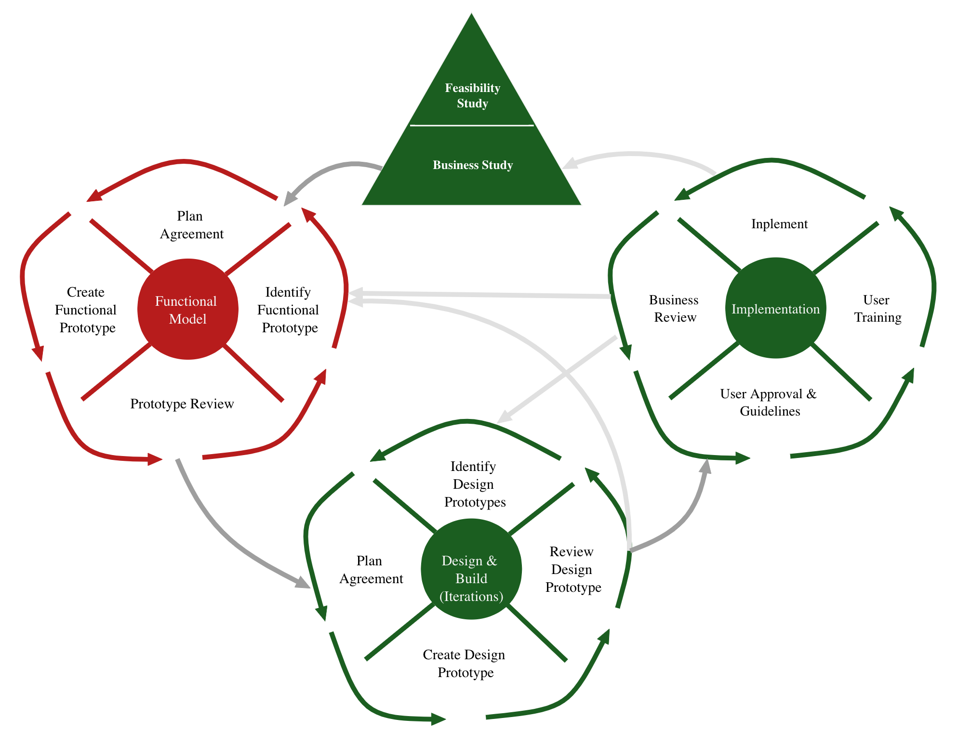
Functional model iteration
Produce functional model of system:
Prototypes
Early versions of the system’s functionality
Documentation
4 activities:
1. Identify what is to be produced
2. Agree how and when to do it
3. Create the product
4. Check that it has been produced correctly

Slide 26
Functional Model Iteration
This phase focuses on building an early version of the system by developing functional prototypes and iterating on them with constant feedback from the business stakeholders.
The aim is to ensure that the system's functionality aligns with the business requirements and that any necessary changes or adjustments are made early in the process.
The Functional Model Iteration Phase allows for early delivery of functional software that stakeholders can interact with and evaluate.

Slide 27
Functional Model Iteration
This helps ensure that the system aligns with business goals and can be adjusted as needed.
The iterative approach fosters close collaboration between the development team and stakeholders, leading to a higher-quality product that better meets user needs.

Slide 28
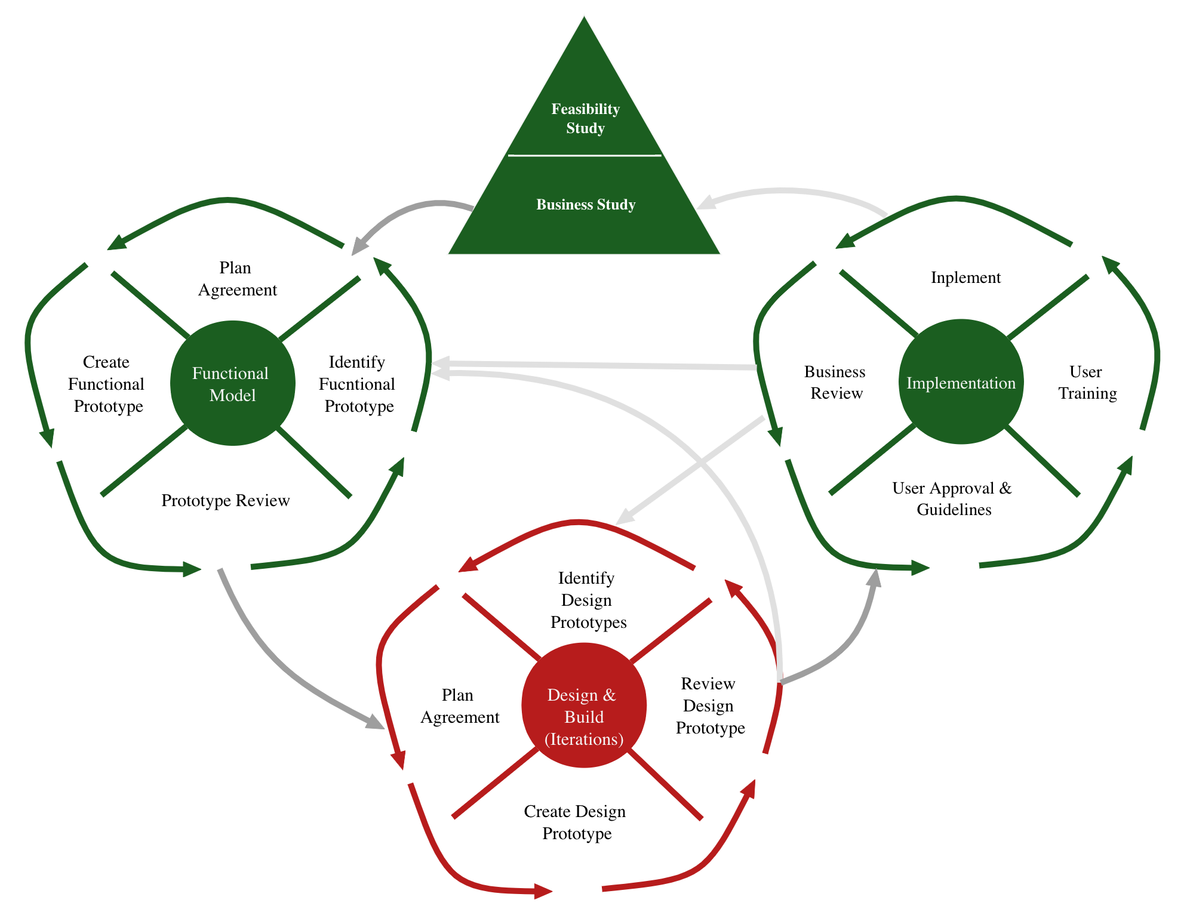
Design and build iteration
Continue to refine the current prototype
Test often
Result is current release of system

Slide 29
Design and Build Iteration
It focuses on the detailed design, development, and integration of the system’s components based on the feedback and functional prototypes created in the earlier phases.
The key goal of this phase is to create the fully functional system, iteratively refining and building on it through ongoing cycles of development and testing.

Slide 30
Design and Build Iteration
This phase is essential for:
Ensuring that the system is scalable and works well in real-world environments.
Refining and optimizing the system’s performance, usability, and functionality.
Ensuring that the system is tested in-depth and is ready for production by the end of the phase.
It is a crucial part of the DSDM methodology because it emphasizes the delivery of value early and often, while still allowing room for adjustments and refinements based on continuous feedback.

Slide 31
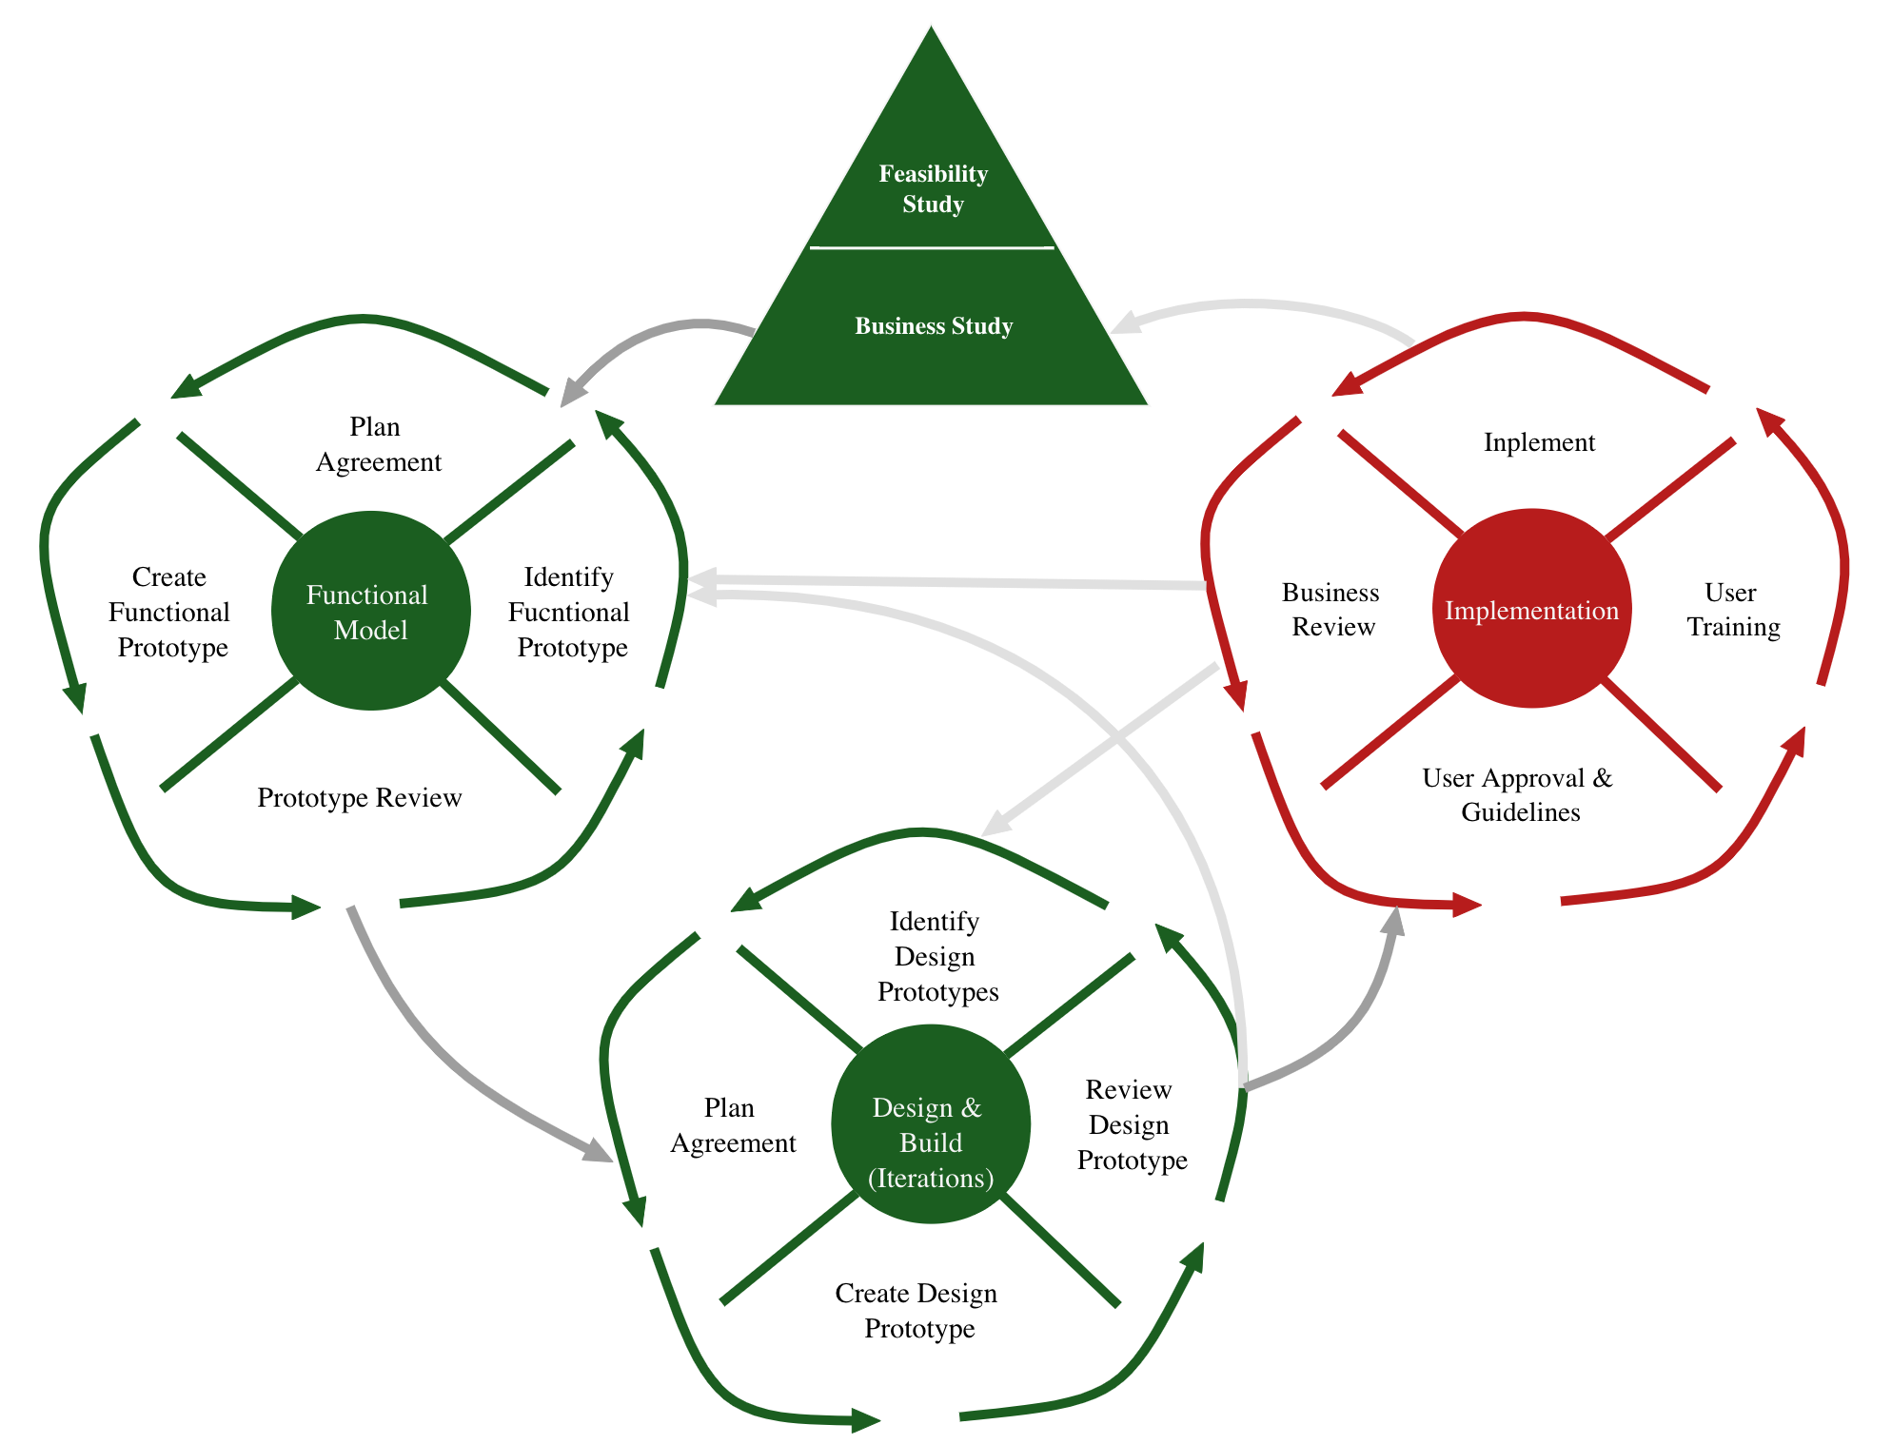
Implementation
Installation and Deployment
Represents cutover to operations
Installation of the completed code
Produce documentation
Train users

Slide 32
Implementation
This phase focuses on delivering the final, working system to the users and making sure that it is fully operational within the business environment.
The main goal of this phase is to transition the system from development to live use, ensuring that the system meets business needs and is stable and well-supported.

Slide 33
Implementation
This phase ensures that:
The system is ready for production, properly configured, and can be supported by users.
Users are trained and can leverage the new system to improve productivity, performance, or whatever specific goals the system was designed to achieve.
There is minimal disruption to the business during the system's transition from development to live use.
The system is sustainable, with the necessary support mechanisms in place to resolve any issues or bugs after deployment.

Slide 34
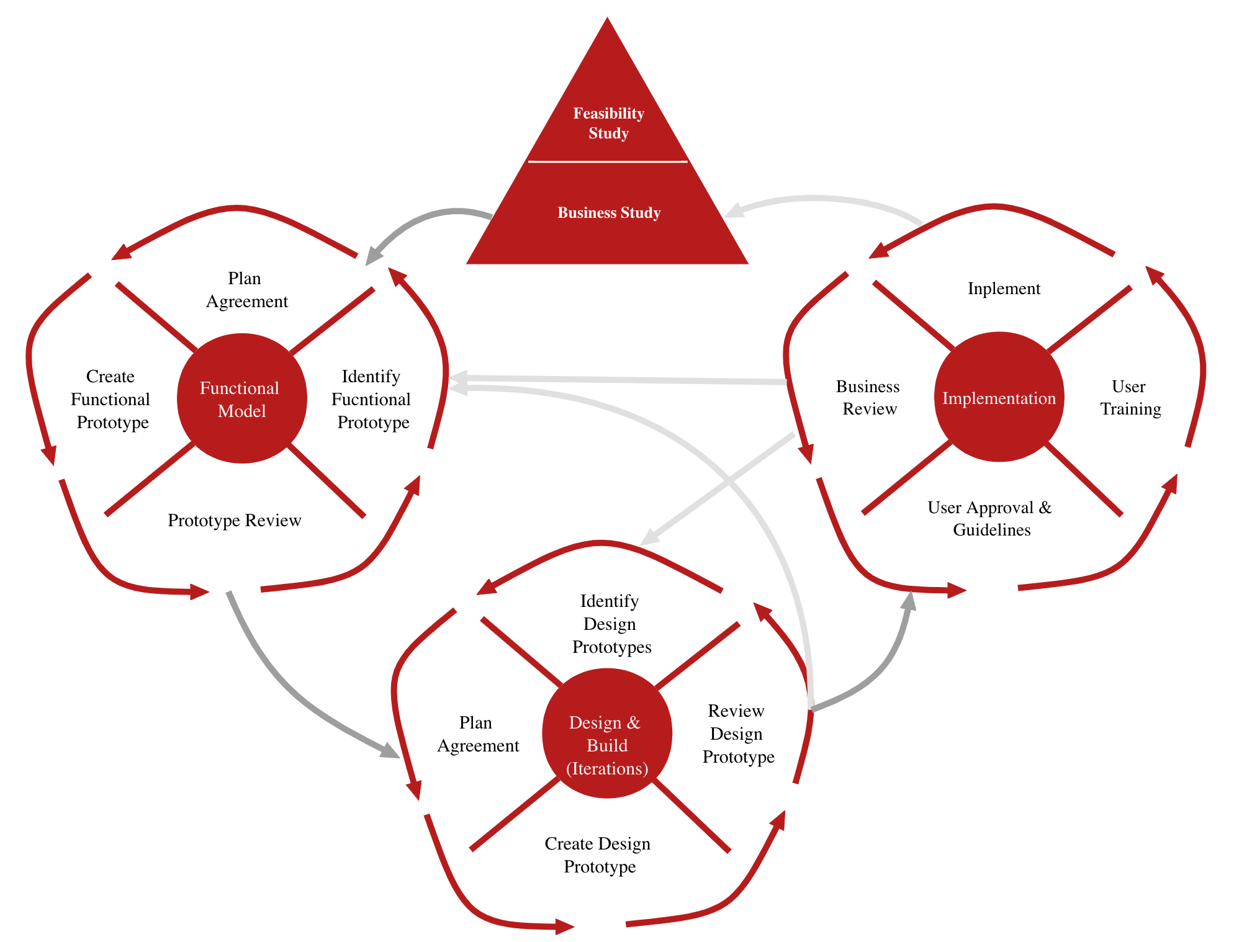
Post-project phase
Support and maintenance of product
Post-project review
DSDM waits until the end of the project to review
Extreme Programming reviews throughout the project

Slide 35
Post-project phase
This phase focuses on the activities that occur after the system has been successfully implemented and is fully operational.
It ensures that the system continues to function well, provides value, and is supported effectively in the long term.
This phase is essential for maintaining the system, addressing any issues that arise, and identifying opportunities for future improvements.
In DSDM, the Post-Project Phase emphasizes continuous improvement, monitoring, and support to ensure that the solution delivers lasting business value.
Delivers lasting business value means that a product, service, or project provides benefits to a business that are not just temporary but continue over a long period.

Slide 36
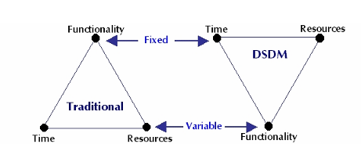
Traditional development VS DSDM
Whereas in traditional development methodologies:
Functionality is fixed, and time and resources are variable
In DSDM, time is fixed, and functionality are variable.
Dynamic Systems Development Method (DSDM) is an organized, common-sense process focused on delivering business solutions quickly and efficiently.
It is similar in many ways to SCRUM and XP, but it has its best uses where the time requirement is fixed.

Slide 37
Core techniques of DSDM and RAD
MoSCoW
Time boxing
Evolutionary prototyping
Facilitated Joint Workshops (JAD)

Slide 38
MoSCoW
Prioritization of requirements
Must have: system is useless without these features
Should have: important requirements, but there is a work-around so that these can be left out for now
Could have: consider for future iterations
Want to have (Waiting list/Won’t have): least important
At each iteration, the team decides which requirements to include
focus on must-haves (60%)
Must include some others (20% should-haves, 20% could-haves)

Slide 39
Time boxing
Set deadlines and adjust requirements and resources
Each increment has a fixed deadline
Each increment should deliver something useful
Development team may drop some deliverables in order to meet deadline
Drop requirements
Acquire third party solution for requirements
Add resources

Slide 40
Prototyping
Rather than spend all the effort to develop a complete system, build a quick prototype to test its feasibility
Prototypes are widely used in most forms of engineering
Low-fidelity (throwaway) prototyping
Quick demonstration of a feature
Result is not useful for development into a product or service
Evolutionary (rapid) prototyping
Rapid construction of a simple feature, often done with special tools
Result may be modified to evolve into the final product or service

Slide 41
Joint Application Design (JAD)
Developed by Chuck Morris and Tony Crawford at IBM in late 1970s
IBM owned 90% of the computing market in the early 1970s
Bring users and developers together to solve a problem
Facilitated joint workshops:
Small team of users and developers work offsite for 1-5 days
Focus on most important features
May create low-fidelity prototypes
May produce detailed specifications of features and functions

